Slide 1

Bakery Project using
By: Syed Daniyal Ahmed Business Intelligence & Data Analyst

Slide 2
Introduction
In today’s data-driven world, even small businesses like bakeries rely on insights from their data to make smarter decisions. A bakery doesn’t just sell cakes and pastries, it manages products, customers, orders, employees, and sales trends.
It is actually MySQL Guided Project and is designed to simulate real-world scenarios where a bakery owner (or analyst) wants to understand:
Which products are selling the most?
Who their most loyal and high-spending customers are?
How sales are distributed across different items?
Employee performance in terms of salary and department comparison.
By: Syed Daniyal Ahmed Business Intelligence & Data Analyst

Slide 3
Overview
This project progresses from simple queries (retrieving data) to advanced analytics using window functions. By the end, you’ll be able to:
Explore datasets and understand their structure.
Calculate percentages and rankings.
Analyze customer spending behavior.
Compare employee salaries across departments.
Solve business-oriented problems using SQL queries.
By: Syed Daniyal Ahmed Business Intelligence & Data Analyst

Slide 4
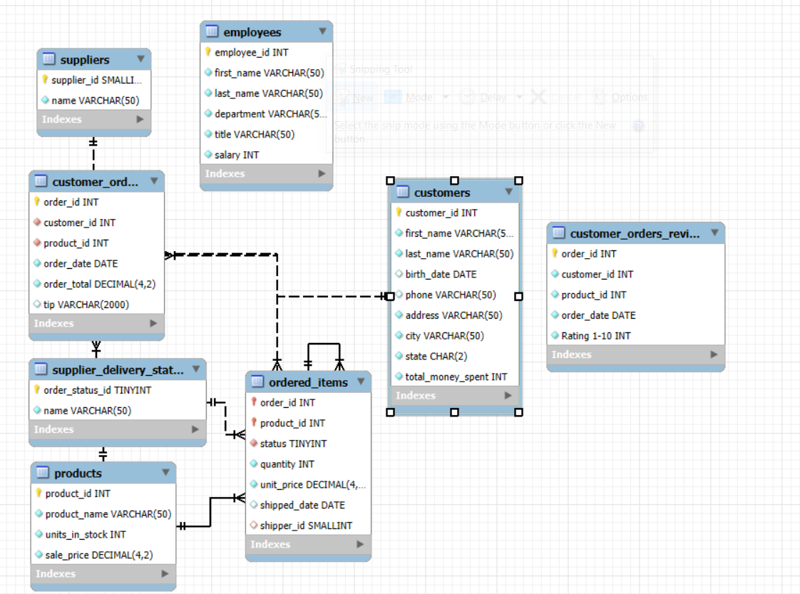
Dataset Overview
By: Syed Daniyal Ahmed Business Intelligence & Data Analyst

Slide 5
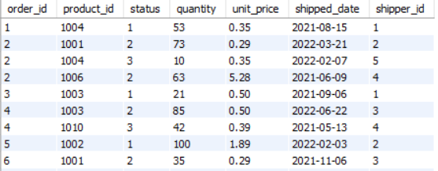
Task 01: What columns are available, and how does the data describe product sales? Explore the ordered_items table.
By: Syed Daniyal Ahmed Business Intelligence & Data Analyst

Slide 6
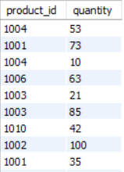
Task 02: Which product IDs and quantities are recorded in the dataset?
Retrieve product IDs and their quantities.
By: Syed Daniyal Ahmed Business Intelligence & Data Analyst

Slide 7
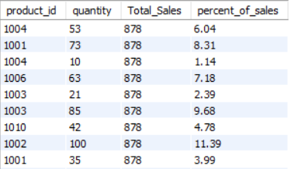
Task 03: How much does each row contribute to overall sales?
Calculate percentage contribution of each order record to total sales.
By: Syed Daniyal Ahmed Business Intelligence & Data Analyst

Slide 8
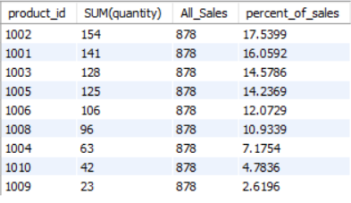
Task 04: Which product contributes the most to bakery sales?
Find percentage contribution of each product to total sales.
By: Syed Daniyal Ahmed Business Intelligence & Data Analyst

Slide 9
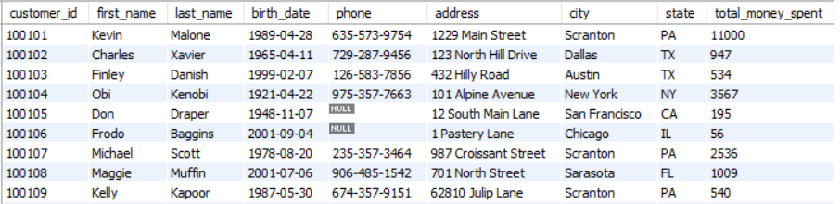
Task 05: What information is stored about customers?
Explore the customers table.
By: Syed Daniyal Ahmed Business Intelligence & Data Analyst

Slide 10
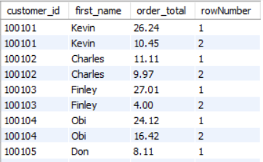
Task 06: What is the maximum order amount for every customer?
Identify each customer’s highest single order value.
By: Syed Daniyal Ahmed Business Intelligence & Data Analyst

Slide 11
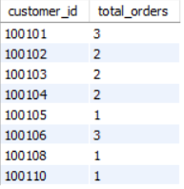
Task 07: What are the top 2 orders for each customer?
Retrieve top 2 highest orders per customer.
By: Syed Daniyal Ahmed Business Intelligence & Data Analyst

Slide 12
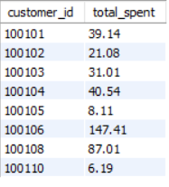
Task 08: Which columns identify orders and spending?
Explore the customer_orders table.
By: Syed Daniyal Ahmed Business Intelligence & Data Analyst

Slide 13
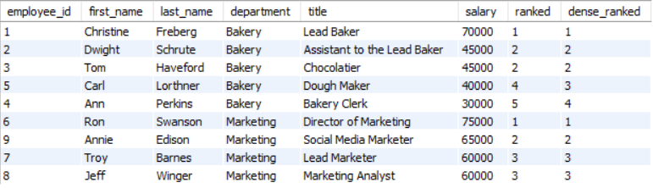
Task 09: What’s the difference between RANK and DENSE_RANK for employees with the same salary?
Rank employees by salary within their departments.
By: Syed Daniyal Ahmed Business Intelligence & Data Analyst

Slide 14
Thank you
By: Syed Daniyal Ahmed Business Intelligence & Data Analyst

